Slide 1
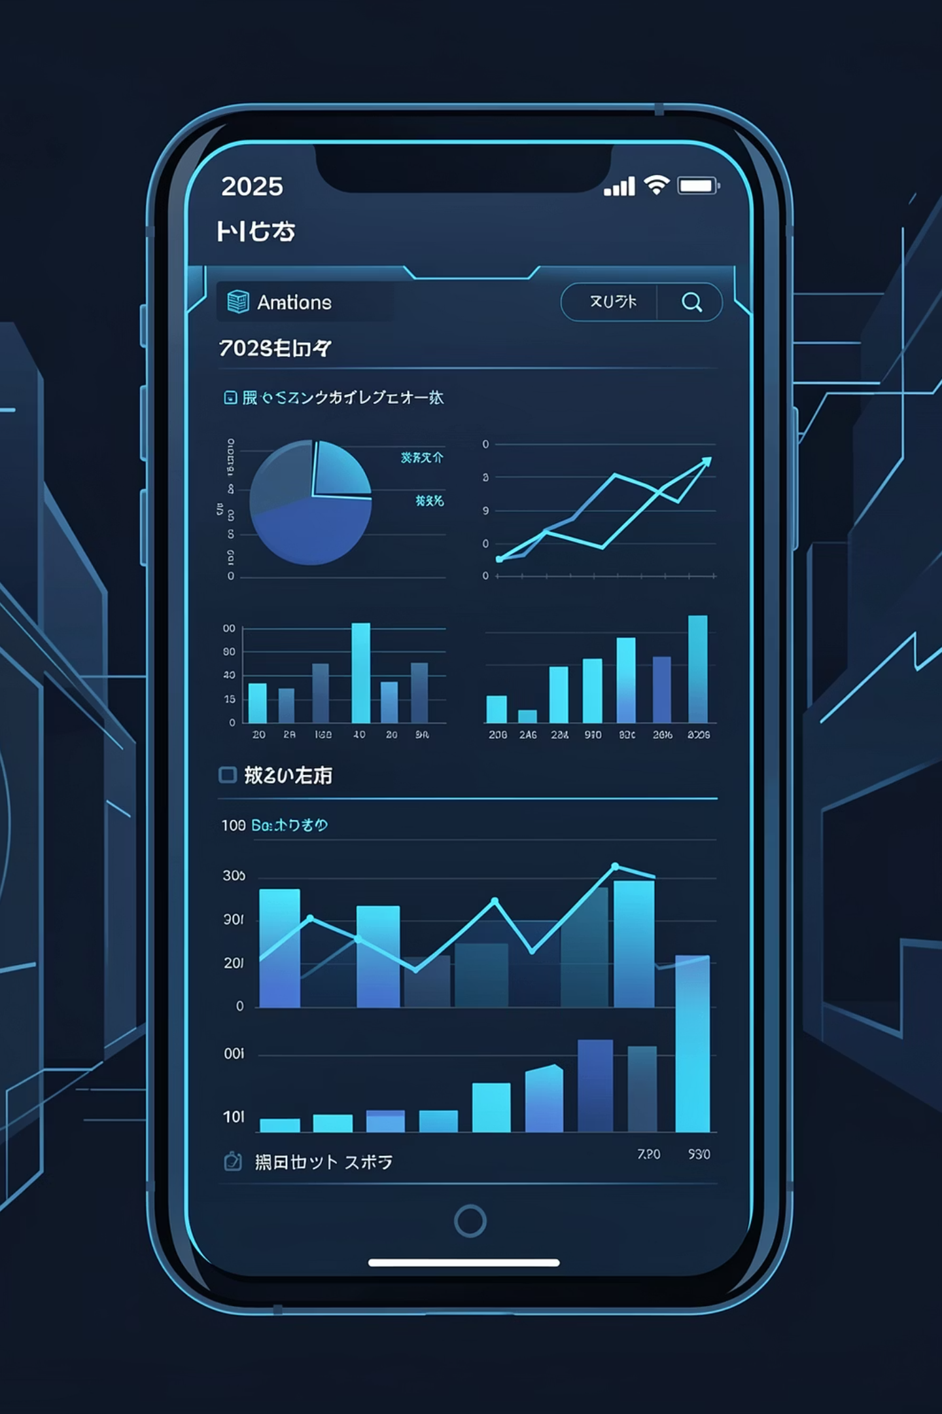
Mobile Market Intelligence Dashboard (2025)
Strategic Analysis of 5,000+ Smartphones
Presented By : SACHIN VK
Tools Used: Excel, Power Pivot, Macros, What-If Analysis

Slide 2

Project Overview
Business Problem & Solution
Manually analyzing specifications and market data for over 5,000 smartphone models presented an insurmountable challenge. Our objective was to transform this raw, unmanageable data into actionable insights.
Instant Comparisons
Interactive Insights
Compare brands, pricing, and specs effortlessly.
Dynamic dashboard for real-time market understanding.

Slide 3




Technical Foundation
How It Was Built: ETL & Modeling
Data Cleaning
Data Modeling
Relationship Resolution
Our methodology involved a robust Extract, Transform, Load (ETL) process combined with advanced data modeling techniques to ensure data integrity and analytical flexibility.
Power Query for Data Cleaning
Star Schema Data Model
Many-to-Many Relationship Resolution
Raw CSV data was meticulously cleaned and transformed. Key operations included splitting combined "RAM/Storage" columns into distinct attributes for granular analysis.
A scalable Star Schema Data Model was constructed within Power Pivot, optimizing performance and facilitating complex queries across various data dimensions.
Advanced techniques were applied to resolve "Many-to-Many" relationship errors, guaranteeing accurate filtering and reliable data aggregation throughout the dashboard.

Slide 4
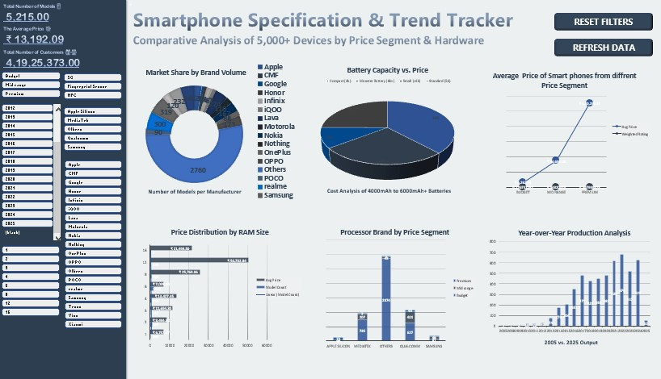
Solution in Action
Executive Dashboard Overview
The interactive dashboard provides business stakeholders with a comprehensive view of the mobile market, enabling data-driven decision-making at a glance.
1
2
3
Dynamic Slicer Panel
Real-time KPI Cards
Market Share & Pricing Visuals
Effortlessly filter data by Brand, Year, and specific Hardware Specifications.
Instantly view critical metrics like "Total Models" and "Avg Price."
Visualize market leadership with a dynamic Donut Chart and track pricing shifts with a clear Line Chart.

Slide 5



Data-Driven Conclusions
Strategic Market Findings
The Market Leader
The 5G Premium
Optimal Value Segment
Our analysis confirms Samsung maintains a dominant position in terms of overall market volume and model diversity.
5G-enabled smartphones command a significantly higher average selling price compared to their 4G counterparts, reflecting advanced technology and early adoption costs.
The ₹15,000 - ₹25,000 price bracket consistently offers the best balance of features and performance, particularly in battery life per rupee invested.

Slide 6

Enhancing User Experience
Advanced Automation: Macros & What-If Analysis
To maximize usability and provide forward-looking insights, the dashboard incorporates advanced automation and analytical tools.
1
2
Reset Filters VBA Macro
Revenue Sensitivity Model
A custom VBA macro was developed to instantly clear all applied filters, ensuring a seamless user experience and quick navigation.
Leveraging Excel's "What-If Analysis," we built a dynamic model to forecast potential revenue fluctuations based on various price changes and market scenarios.

Slide 7

Summary & Future Scope
This project successfully delivered an end-to-end Business Intelligence solution, transforming complex mobile market data into interactive, actionable insights for strategic decision-making.
Scalability
The current architecture is ready to handle even larger datasets.

